Slide 1
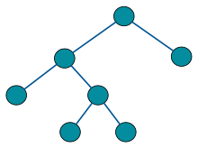
Binary Trees
8.2
This Photo by Unknown Author is licensed under CC BY-SA

Slide 2
Binary Trees
A binary tree is a tree with the following properties:
Each internal node has at most two children
(exactly two for proper binary trees)
The children of a node are an ordered pair
We call the children of an internal node left child and right child
A
B
C
D
E
F
G
H
I

Slide 3
Binary Trees
Alternative recursive definition: a binary tree is either
an empty tree or
a nonempty tree with a root
has an ordered pair of children, each of which is a binary tree (each may be empty)
A
B
C
D
E
F
G
H
I

Slide 4
Binary Trees
A
Applications:
arithmetic expressions
decision processes
searching
B
C
D
E
F
G
H
I

Slide 5
Binary Tree Usage: Arithmetic Expression Tree
Binary tree associated with an arithmetic expression
internal nodes: operators
external nodes: operands
Example: arithmetic expression tree for the expression (2 × (a - 1) + (3 × b))
+
×
×
2
−
3
b
a
1

Slide 6
Binary Tree Usage: Decision Tree
Binary tree associated with a decision process
internal nodes: questions with yes/no answer
external nodes: decisions
Example: dining decision
Want a fast meal?
Yes
No
How about coffee?
On expense account?
Yes
No
Yes
No
Starbucks
Chipotle
Gracie’s
Café Paragon

Slide 7
Binary Tree ADT
8.2.1

Slide 8
BinaryTree ADT
The BinaryTree ADT extends the Tree ADT, i.e., it inherits all the methods of the Tree ADT
Additional methods:
Position left(p)
Position right(p)
Position sibling(p)
The above methods return null when there is no left, right, or sibling of p, respectively

Slide 9
BinaryTree ADT
Update methods may be defined by data structures implementing the BinaryTree ADT

Slide 10
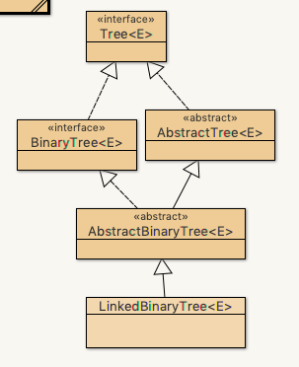
Binary Tree Interface
Open up DSAJ-sourcecode with BlueJ
find package net.datastructures
open
file BinaryTree.java
Locate methods
left()
right()
sibling()
Notes:
Only interface methods

Slide 11
Properties of Binary Trees
8.2.2

Slide 12
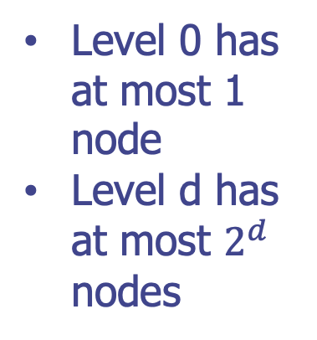
Properties of Binary Trees
The set of nodes at the same depth is the level d of T
Level 0 has at most 1 node
Level d has at most $2^{d}$ nodes

Slide 13
Proper and Improper Binary Trees
A binary tree is proper if each node has either zero or two children.
Also known as a full binary tree
A binary tree that is not proper is improper.

Slide 14
Properties of Binary Trees
Notation
n number of nodes
e number of external nodes
i number of internal nodes
h height

Slide 15
Properties of Proper Binary Trees
Properties:
e = i + 1
Number of external nodes = internal nodes +1
n = 2e − 1
Total number of nodes = 2*external nodes -1
h ≤ i
The height is <= internal nodes

Slide 16
Properties of Proper Binary Trees
Properties:
h ≤ (n − 1)/2
The height is <= (number of nodes-1)/2
e ≤ 2^{h}
external nodes <= 2 to the h power
h ≥ log₂ e
Height is >= log base 2 of number of external nodes
h ≥ log₂ (n + 1) – 1
Height is >= log base 2 of (n+1) - 1

